Slide 1



MongoDB
Mongo DB

Slide 2
What is MongoDB?
MongoDB is a document oriented NoSql database for storing high volume data.
Flexible Schema
Easy to Scale
Handles Unstructured data
Distributed database

Slide 3
MongoDB Data Model
Database
Shop
Collections
Users
Orders
Products
Documents
{name:”John”,age:32…}
{orderId:1,amount:30$...}
{………….}
{name:”Mary”…}
{orderId:2,country:IN,amount:50$...}
{………….}
{name:”Scarlet”,email:”s@gmail.com”…}
{orderId:3,amount:75$...}
{………….}

Slide 4

MongoDb Features
1. Adhoc Queries
4. Load Balancing
range query and regular expression
Automatic Load Balancing
2. Indexing
5. Flexible Schema
Performance improvement
Schema less database.
3. Replication
6. Auto Sharding
Master Slave Replication
data is across multiple physical partitions called shards.
Master for read/write & Workers for read.
7. High Availability

Slide 5
MongoDB
SQL
No Schema
Schema evolution easy
Denormalized data
No Joins
Fetching is fast
Rigid Schema
Schema evolutions hard
Normalized data
Joins
Fetching joined data is slower

Slide 6

JSON
BSON
{
“name”: “Titanic”,
“rating: 4.5,
“released_year”:2009,
“actors”:
[“Leonardo DiCaprio”,” Kate Winslet”]
}
Binary Data
Mongo
Driver

Slide 7
Where to Use?
E-Commerce applications
Social & Networking website
Blog & Content Management Systems
Applications that have changing or
flexible schema
High Speed logging in the Real time
Location wise Geospatial data

Slide 8
Limitations?
Maximum document size – 16MB
Not Ideal for ACID operations
Maximum Nesting – 100 levels
Not Ideal for complex join queries
DB name is limited to 64 chars
Triggers, Stored Procedures not supported
Max Indexes per Collections - 64

Slide 9
Local Setup
MongoDb Atlas(Cloud)

Slide 10
CRUD Operations
Create
Update
Read
Delete
insertOne
insertMany
updateOne
updateMany
replaceOne
find
findOne
deleteOne
deleteMany

Slide 11
MongoDB Array
setup

Slide 12
Find the first matching movie whose name is Titanic and change its rating to 5
db.movies.
updateOne(
{“name”:”Titanic”},
{rating:5}}
{$set:
)

Slide 13
Find the all movie whose name is Titanic and change its rating to 5
db.movies.
updateMany(
{“name”:”Titanic”},
{rating:5}}
{$set:
)

Slide 14
Add field
Add a new field in all documents named country and assign “India” as its value
db.movies.
updateMany(
{},
{“country”:”India”}}
{$set:
)

Slide 15
update field
Update all the documents and change the country to US
db.movies.
updateMany(
{},
{“country”:”US”}}
{$set:
)

Slide 16
Lecture Summary
Update single document based on filter
db.movies.updateOne({name: “Titanic”},{$set: {rating: 5}})
Update multiple document based on filter
db.movies.updateMany({year: 2005}, {$set: {rating:3}})
Update all documents/ Add a field
db.movies.updateMany({},{$set: {country: “India”}}
Update all documents/ update a field
db.movies.updateMany({},{$set: {country: “US”}}

Slide 17
Remove field
Remove rating from a movie document where movie name is Inception
db.movies.
updateMany(
{name: “Inception”},
{“rating”: “”}}
{$unset:
)

Slide 18
Rename field
Update all document to rename rating field to ratings_customer
db.movies.
updateMany(
{},
{$rename:
{“rating”:”rating_customer”}}
)

Slide 19
Replace Document
Update the movie document with movie name:“Inception” with a new movie document
db.movies.
update(
{“name”:”Inception”},
{
“name”:”Inception-new”,
“rating”:4}
)

Slide 20
Delete

Slide 21
Delete a single movie whose name is Sunshine
db.movies.
deleteOne(
{“name”:”Sunshine”}
)

Slide 22
Delete all movies published in year 2001
db.movies.
deleteMany(
{“year”:2001}
)

Slide 23
Delete all documents from a collection
db.movies.
deleteMany(
{}
)

Slide 24
Drop Collection
db.movies.
drop()

Slide 25
Drop Database
db.dropDatabase()

Slide 26
Lecture Summary
Delete Single documents based on some condition
db.movies.deleteOne({name: “Sunshine”})
Delete Multiple documents based on some condition
db.movies.deleteMany({country: “India”})
Delete All documents
db.movies.deleteMany({})
Drop Collection
db.movies.drop()
Drop Database
db.dropDatabase()

Slide 27
Projections

Slide 28
Display only the movie name, year published in the find operation.
db.movies.
find(
{},
{name:1,
year:1}
)

Slide 29
Display only the movie name, year published in the find operation whose rating is 4.
db.movies.
find(
{rating:4},
{name:1,
year:1}
)

Slide 30
Ordered Inserts

Slide 31
db.moviesNew.
insertMany([
{_id:”titanic”,name:”Titanic”},
{_id:”sunshine”,name:”Sunshine”}
])

Slide 32
db.moviesNew.
insertMany([
{_id:”titanic”,name:”Titanic”},
{_id:”inception”,name:”Inception”}
])

Slide 33
db.moviesNew.
insertMany([
{_id:”titanic”,name:”Titanic”},
{_id:”inception”,name:”Inception”}]
,{ordered:false})

Slide 34
Working with operators

Slide 35
In Operator
Find all movies whose name belong to this list – Titanic,Inception,Sunshine
db.movies.
find(
{$in: [“Titanic”,
”Inception”,
“Sunshine”]}
{name:
})

Slide 36
nin Operator
Find movies except these movies whose name is Inception& Sunshine
db.movies.
find(
{$nin: [
”Inception”,
“Sunshine”]}
{name:
})

Slide 37
gte Operator
Display all movies whose rating is greater than equal to 4
db.movies.
find(
{$gte:4}
{rating:
)

Slide 38
lte Operator
Display all movies whose rating is lesser than 4
db.movies.
find(
{$lte:4}
{rating:
)

Slide 39
or Operator
Display all movies whose rating is either greater than 4 or released year is 2001
db.movies.
find(
{$or:
[
{rating: {$gte:4},
{year: 2001}
]}
})

Slide 40
and Operator
Display all movies whose rating is either greater than 4 and genre year is 2001
find(
db.movies.
{$and:
[
{rating: {$gte:4},
{year: 2001}
]}
})

Slide 41
regex Operator
Display all movies whose descriptions is having “idiots” in it.
db.movies.
find(
{$regex: \idiot\ } }
{description:
)

Slide 42
type Operator
Find the author whose phone field is of type text
db.author.insertMany{[
{name: “shakespeare”,phone:8800178},
{name: “tesla”,phone:”7783893939”},
]}
}
phone: {$type: “number”}
db.author.find{

Slide 43
Working with Arrays

Slide 44
Display all movies actor name is Leonardo Dicaprio
db.movies.
find(
“Leonardo Dicaprio”}
{“actors.name”:
).pretty()

Slide 45
Find all movies whose genre has drama and romance
db.movies.
find(
{“genre”: [“drama”,”romance”]}
).pretty()

Slide 46
Find all movies whose actor name is Leonardo Dicaprio and movies genre has “romance” in it
db.movies.
find(
{“$and: [
{“actor.name”: “Leonardo Dicaprio”}
{“genre”: {&all:[“romance”]}}
}]
).pretty()

Slide 47
Adding/ Removing
with
Arrays

Slide 48
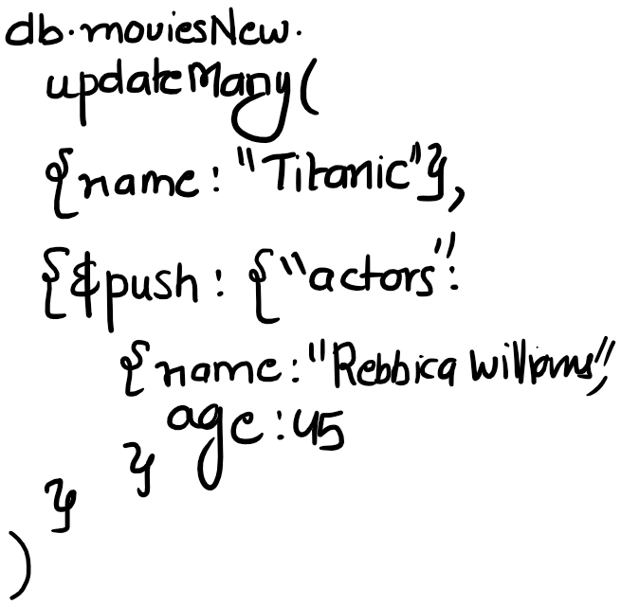

Slide 49
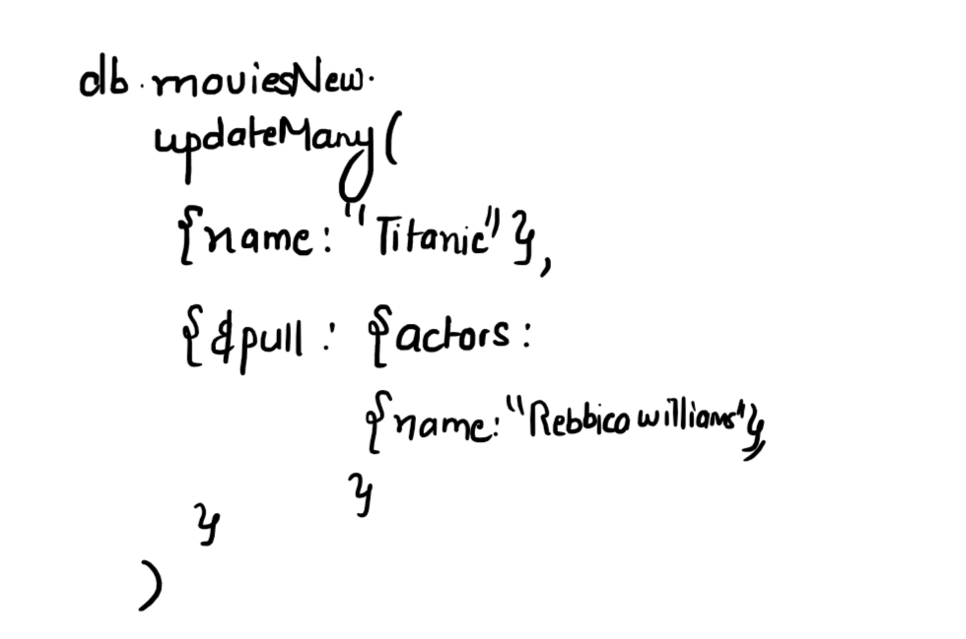

Slide 50
Thank You

